Slide 1


Beyond Islands of Regularity:
Evidence against morpho-orthographic decomposition
Roberto Petrosino, Jon Sprouse & Diogo Almeida
roberto.petrosino@nyu.edu ~ www.robertopetrosino.com
WoProc 2026
Lisbon, Portugal

Slide 2
Introduction
painter
Notes:
The psycholinguistic research on word recognition of the past 30 years have shown that before even being visually recognized, words are first broken down into smaller orthographic units, that seem to correspond to realizations of abstract morphemes. This procedure is known as _morphological decomposition.

Slide 3
Introduction
paint
er
Notes:
The psycholinguistic research on word recognition of the past 30 years have shown that before even being visually recognized, words are first broken down into smaller orthographic units, that seem to correspond to realizations of abstract morphemes. This procedure is known as _morphological decomposition.

Slide 4
Introduction
paint
er
Notes:
The psycholinguistic research on word recognition of the past 30 years have shown that before even being visually recognized, words are first broken down into smaller orthographic units, that seem to correspond to realizations of abstract morphemes. This procedure is known as _morphological decomposition.

Slide 5
Introduction
morphological decomposition:
procedure that breaks words down into smaller orthographic units
that correspond to the realizations of abstract morphemes
paint
er

Slide 6
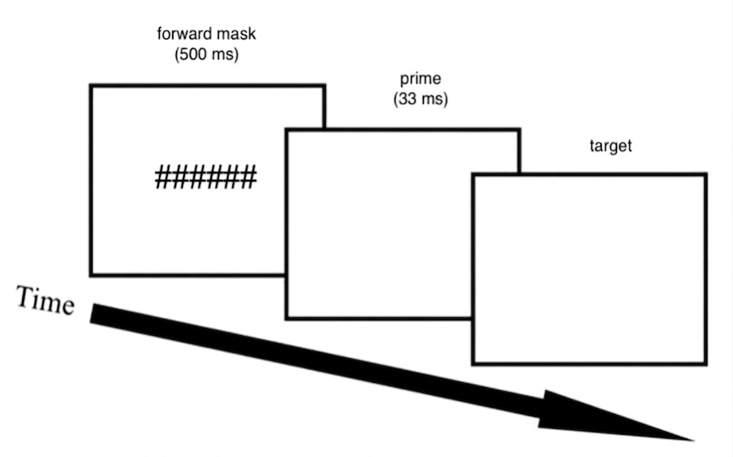
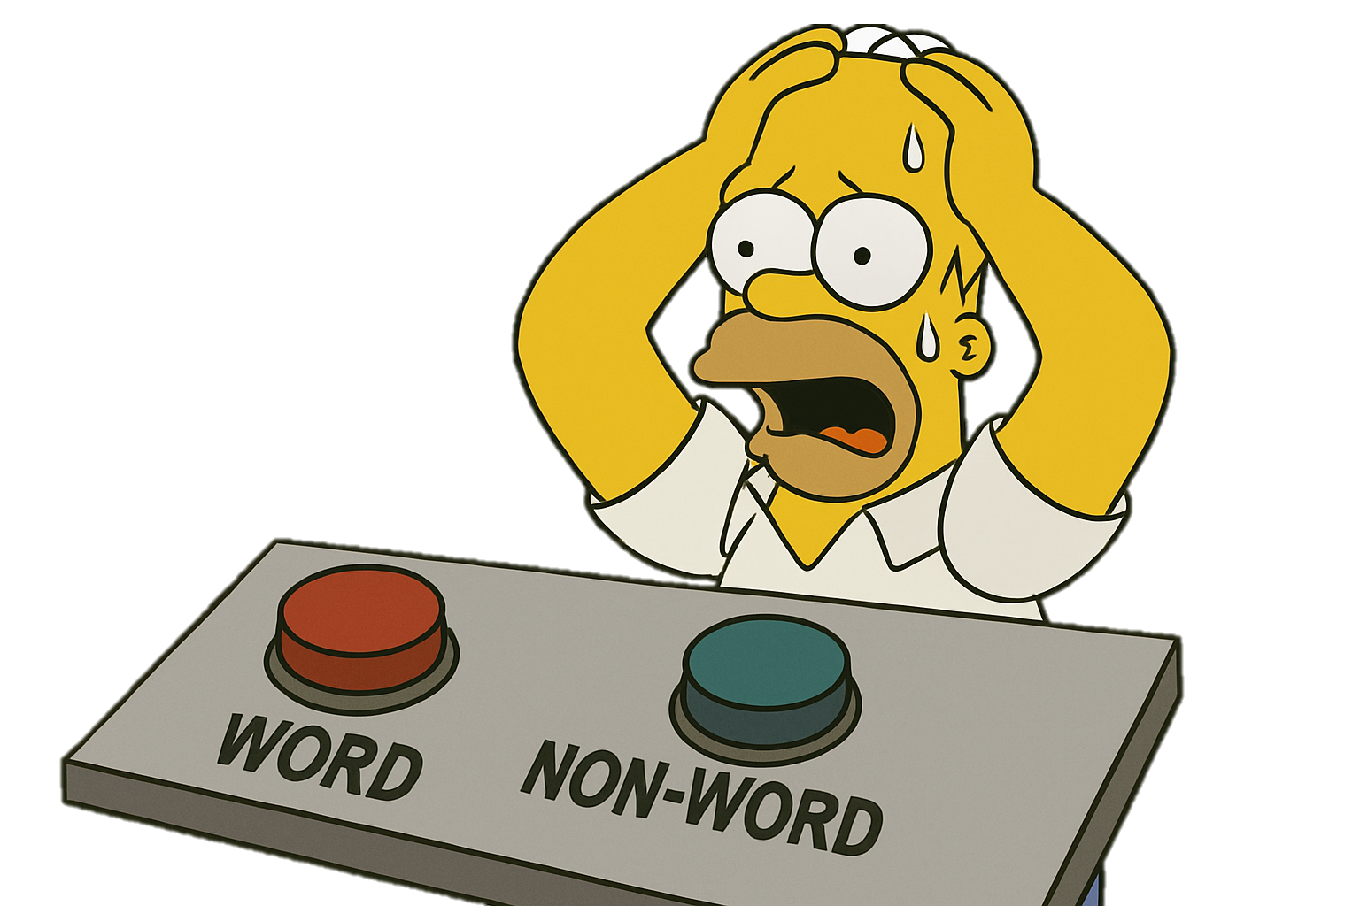
Introduction
masked priming
In the masked priming design, the brief prime presentation (33-60 ms) prevents it from being consciously perceived, thus probing into early stages of word processing.
painter
PAINT
Notes:
The primary source of evidence for this procedure comes from the masked priming lexical decision design. In this design, a derived word is presented for about 30-60 ms, and immeditely followed by the corresponding stem, on to which participants are asked to make a lexical decision. The brief presentation of the prime makes sure that it is not consciously perceived by participants, and allows to tap into early stages of processings, factoring out later stages and extra-linguistic factors.

Slide 7
Introduction
Rastle et al. 2004 – ’morpho-orthography’
“transparent”
“opaque”
form
Notes:
The seminal masked priming study arguing for morphological decomposition dates back to 2004, and tested three main conditions.

Slide 8
Introduction
Rastle et al. 2004 – ’morpho-orthography’
“transparent”
“opaque”
Dissociation of the morphological level from the pure orthographic level of analysis
form

Slide 9
Introduction
Rastle et al. 2004 – ’morpho-orthography’
“transparent”
“opaque”
Similar effects for
morphologically and orthographically
complex words
form
Notes:
Notice that this pattern of results cannot be explained in distributed models in which visual word recognition results from the distributed activation of orthographic and semantic nodes.

Slide 10
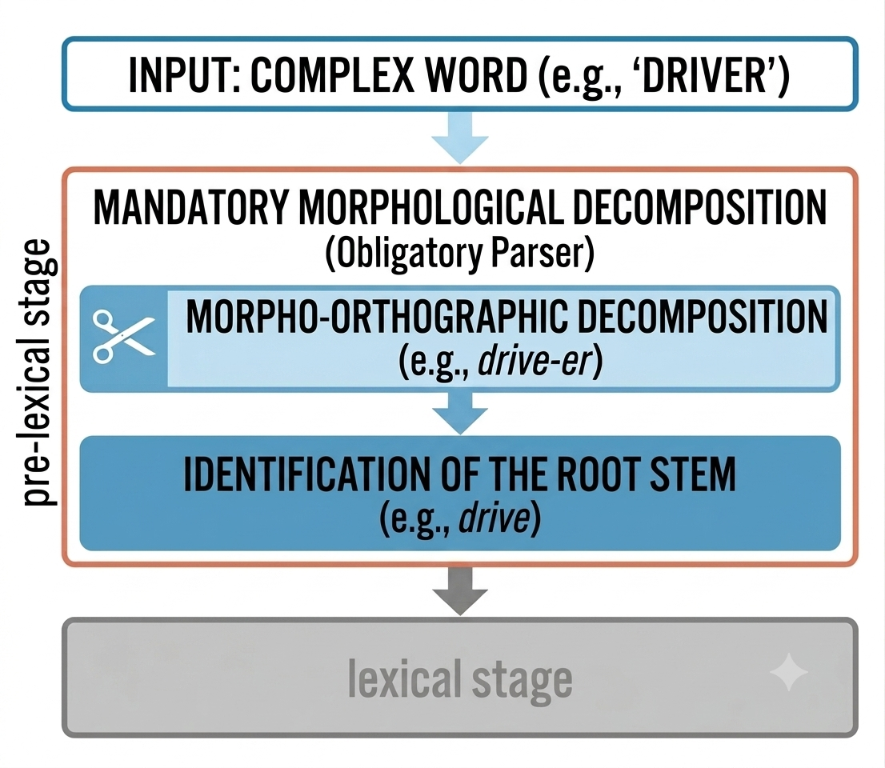
Introduction
a model of morphological processing
Blind Morpho-Orthographic Decomposition (BMOD) model
(Taft & Forster 1979; Taft 2004; Rastle et al. 2008)
The results suggest a morphological decomposition procedure that is:
sensitive to islands of regularity, i.e. morpho-orthographic statistical regularities across letter clusters; and
blind to “lexical” properties (lexicality, semantics)
Notes:
This procedure is therefore a pretty ‘dumb’ operation, that does not have anything really linguistic per se despite often being described as morphological decomposition. It is just a visual process informed by low-level recurrences of letters clustered together.
When people think about word processing, they make a sharp distinction between pre and post lexical, but this distinction is kind murky. Masked priming allowed to zoomed in the pre-lexical stage, which was further fed by Rastle’s evidence on opaque priming. The debate is about pre-lexical decomposition, so avoid/gloss over any reference to whatever happens in the post-lexical stage (e.g. recombination or semantic integration).

Slide 11
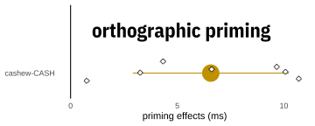
This study
Issue 1 – underestimation of form priming
  M_{cashew-CASH} ≈ 0
high variance!
presented to you by Crystal!
prime lexicality?
counter to the prediction of the BMOD model
(Morris et al. 2011)
some other factor?
The absence of form priming seems to be a case of acceptance fallacy:
the effect was reported to be small and non-significant and assumed to be null thereafter.
Notes:
Since Rastle’s seminal paper, many sunsequent studies have confirmed similar results in English, as well as other languages (Italian, French, Spanish, Russian, Serbo-Croatian, Hebrew, Arabic, Tagalog, Tswana).
This study was originally conceived after identifying two major issues in the stem masked priming literature that seem to have been overlooked.

Slide 12
This study
Issue 1 – underestimation of form priming
  M_{cashew-CASH} ≈ 0
high variance!
presented to you by Crystal!
prime lexicality?
counter to the prediction of the BMOD model
(Morris et al. 2011)
some other factor?
orthographic syllabification
The absence of form priming seems to be a case of acceptance fallacy:
the effect was reported to be small and non-significant and assumed to be null thereafter.
Notes:
Since Rastle’s seminal paper, many sunsequent studies have confirmed similar results in English, as well as other languages (Italian, French, Spanish, Russian, Serbo-Croatian, Hebrew, Arabic, Tagalog, Tswana).
This study was originally conceived after identifying two major issues in the stem masked priming literature that seem to have been overlooked.

Slide 13
This study
Issue 1 – Tackling the underestimation of form priming
cashew-CASH
against-AGAIN

Slide 14
This study
Issue 1 – Tackling the underestimation of form priming
cash.ew-CASH
a.gainst-AGAIN

Slide 15
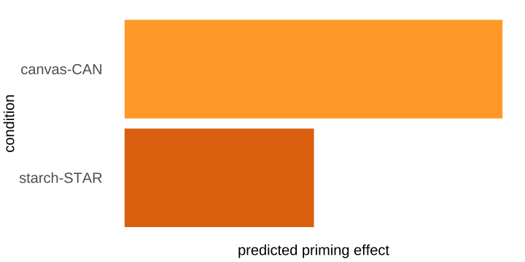
This study
Issue 1 – Tackling the underestimation of form priming
cash.ew-CASH
a.gainst-AGAIN
the combination of pairs involving syllabic or non-syllabic endings might have depressed the effect
Two separate form priming conditions were tested:
  orthographic syllabic (CVC) condition: can.vas-CAN
  orthographic non-syllabic condition: starch-STAR

Slide 16
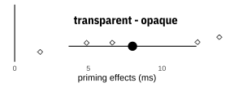
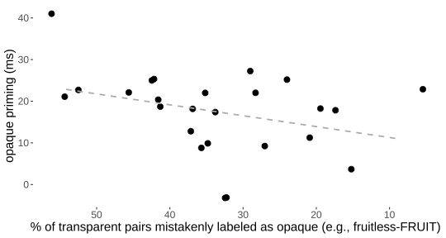
This study
Issue 2 – the overestimation of opaque priming
  (M_{painter-PAINT} ≈ M_{corner-CORN}) > M_{cashew-CASH}
Meta-analysis: M_{painter-PAINT} > M_{corner-CORN}
no agreed-upon definition of morphological ”opacity”
  mislabeling issue
  fruitless-FRUIT; planet-PLAN
  a function of cosine similarity?
  (Marelli & Baroni 2015)
Notes:
transparent and opaque priming being different
1. cosine similarity matter -> predicted to be a cline (Marelli)
2. opaque is a mix bag

Slide 17
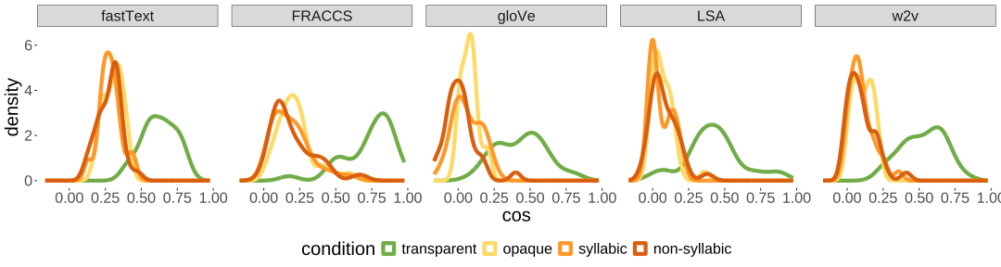
This study
Issue 2 – tackling the overestimation of opaque priming
Stricter opacity selection criteria:
  no etymologically related words (e.g., helmet-HELM)
  no ambiguous parses (e.g., united-UNIT)
  no unproductive suffixes (e.g., planet-PLAN)
  semantic similarity assessment via current DSMs

Slide 18
This study
Issue 3 – statistical power
Low statistical power is a long-standing issue in the field (Brysbaert & Stevens 2019), leading to:
  miss to detect a true effect
  fail to provide an accurate estimate
  effect overestimation/directionality reversal
We addressed this issue by carrying out 6 replications of the same experiment.
# | Setting | Platform | Prime duration | Recruitment | Sample size
1 | in-lab | PsychoPy | 2 frames | University | 83
2 | online | PsychoJS | 33 ms | AMT | 139
3 | online | PsychoJS | 2 frames | AMT | 138
4 | online | Labvanced | 33 ms | Prolific | 167
5 | online | Labvanced | 33 ms | Prolific | 400
6 | online | Labvanced | 33 ms | Prolific | 3000

Slide 19
This study
Issue 3 – statistical power
Low statistical power is a long-standing issue in the field (Brysbaert & Stevens 2019), leading to:
  miss to detect a true effect
  fail to provide an accurate estimate
  effect overestimation/directionality reversal
We addressed this issue by carrying out 6 replications of the same experiment.
# | Setting | Platform | Prime duration | Recruitment | Sample size
1 | in-lab | PsychoPy | 2 frames | University | 83
2 | online | PsychoJS | 33 ms | AMT | 139
3 | online | PsychoJS | 2 frames | AMT | 138
4 | online | Labvanced | 33 ms | Prolific | 167
5 | online | Labvanced | 33 ms | Prolific | 400
6 | online | Labvanced | 33 ms | Prolific | 3000

Slide 20
This study
Issue 3 – statistical power
Low statistical power is a long-standing issue in the field (Brysbaert & Stevens 2019), leading to:
  miss to detect a true effect
  fail to provide an accurate estimate
  effect overestimation/directionality reversal
We addressed this issue by carrying out 6 replications of the same experiment.
# | Setting | Platform | Prime duration | Recruitment | Sample size
1 | in-lab | PsychoPy | 2 frames | University | 83
2 | online | PsychoJS | 33 ms | AMT | 139
3 | online | PsychoJS | 2 frames | AMT | 138
4 | online | Labvanced | 33 ms | Prolific | 167
5 | online | Labvanced | 33 ms | Prolific | 400
6 | online | Labvanced | 33 ms | Prolific | 3000
 |  |  |  | total | 3,927

Slide 21
This study
replications #1 - #5
# | Setting | Platform | Prime duration | Recruitment | Sample size
1 | in-lab | PsychoPy | 2 frames | University | 83
2 | online | PsychoJS | 33 ms | AMT | 139
3 | online | PsychoJS | 2 frames | AMT | 138
4 | online | Labvanced | 33 ms | Prolific | 167
5 | online | Labvanced | 33 ms | Prolific | 400
6 | online | Labvanced | 33 ms | Prolific | 3000
total |  |  |  |  | 927
Replications #1-#5 underwent the same analysis pipeline and then a varying-coefficient (VC) meta-analysis (Bonett 2009).
Notes:
This method provides reliable effect estimates without assuming homogeneity of the effect sizes (unlike the fixed-coefficient model), nor random sampling (unlike the random-coefficient model) across studies.

Slide 22
This study
replications #1 - #5
identity: fuss-FUSS
transparent: painter-PAINT
opaque: wander-WAND
non-syllabic: starch-STAR
syllabic: canvas-CAN
32 stimuli for each condition
Prime and target words were controlled for HAL frequency and orthographic length across conditions.
Notes:
Identity represents the upper limit baseline.
Syllabic vs non-syllabic test the syllabification procedure we hypothesized before.
Surprisingly, this is one of the few studies (if not the only one) that tested all these conditions together

Slide 23
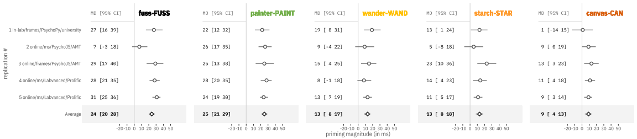
This study
replications #1 - #5 — VC meta-analytic results
Notes:
The error bars show 95% CIs of that specific study.
The shaded rectangles represent the 95% prediction intervals of the previous study onto the next.
95% PI gives a range of values one expect to find in a given replication of the previous study if the variance is just due to random sampling. Basically if the results for a specific condition in a given study are within the corresponding prediction intervals, they can be considered a replication of the previous study.
A prediction interval defines a range of possible effect sizes that can be expected in a replication due only to sampling error. In other words, if the only difference between the original study and the replication study is sampling variability, we should expect the effect sizes of one replication study to fall within the 95% PI set by the previous study.

Slide 24
Interim summary
These results challenge the BMOD model that would instead predict M_{opaque} ≈ M_{transparent}
At the same time, they are compatible with two different models of (visual) word recognition.

Slide 25
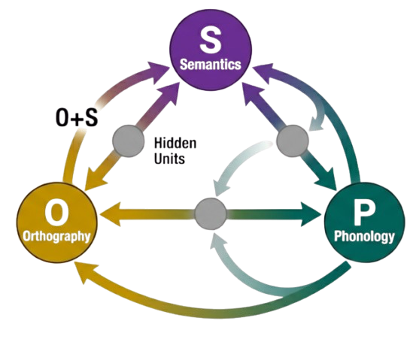
Interim summary
These results challenge the BMOD model that would instead predict M_{opaque} ≈ M_{transparent}
At the same time, they are compatible with two different models of (visual) word recognition.
1. Connectionist Triangle Model
(Seidenberg & McClelland 1989)
morphology as an emergent property of the interaction between the semantic, orthographic and phonological levels
effect additivity: any measure is (roughly) a direct linear summation of at least two levels of analysis

Slide 26
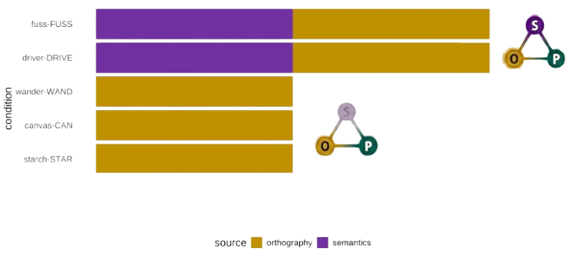
Interim summary
These results challenge the BMOD model that would instead predict M_{opaque} ≈ M_{transparent}
At the same time, they are compatible with two different models of (visual) word recognition.
1. Connectionist Triangle Model
(Seidenberg & McClelland 1989)
Notes:
Don’t forget to mention that the prediction here refer to our items, but they may change depending on the stim list. For example, the items may be predicted to show a cline in the priming response as a function of
semantic similarity (cosine) – Marelli & Baroni 2015; and/or
the interaction between semantic and orthographic similarity – e.g., Marelli et al. 2017; Amenta et al. 2020 (OSC).

Slide 27
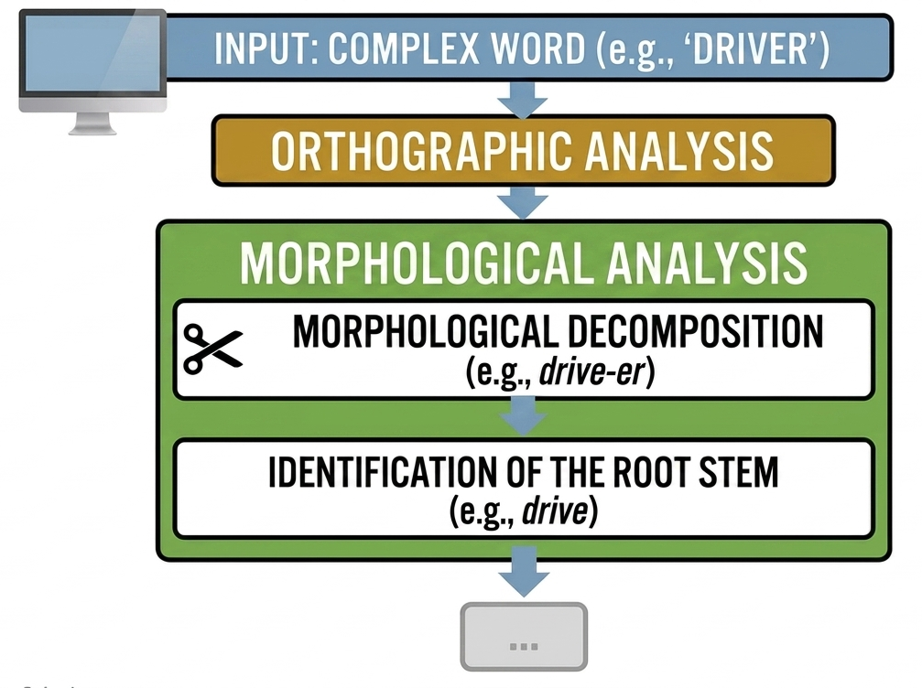
Interim summary
These results challenge the BMOD model that would instead predict M_{opaque} ≈ M_{transparent}
At the same time, they are compatible with two different models of (visual) word recognition.
2. Lexical Decomposition
Model
Morphology is an independent level of analysis:
separate from orthography: it relies on the actual morphological structure of words, rather than morpho-orthographic regularities; and
occurring as a stage of lexical access.
Notes:
Remove lexical recombination

Slide 28
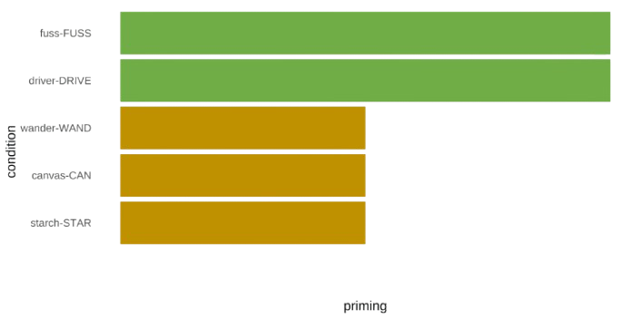
Interim summary
These results challenge the BMOD model that would instead predict M_{opaque} ≈ M_{transparent}
At the same time, they are compatible with two different models of (visual) word recognition.
2. Lexical Decomposition
Model
Notes:
Three steps effect

Slide 29
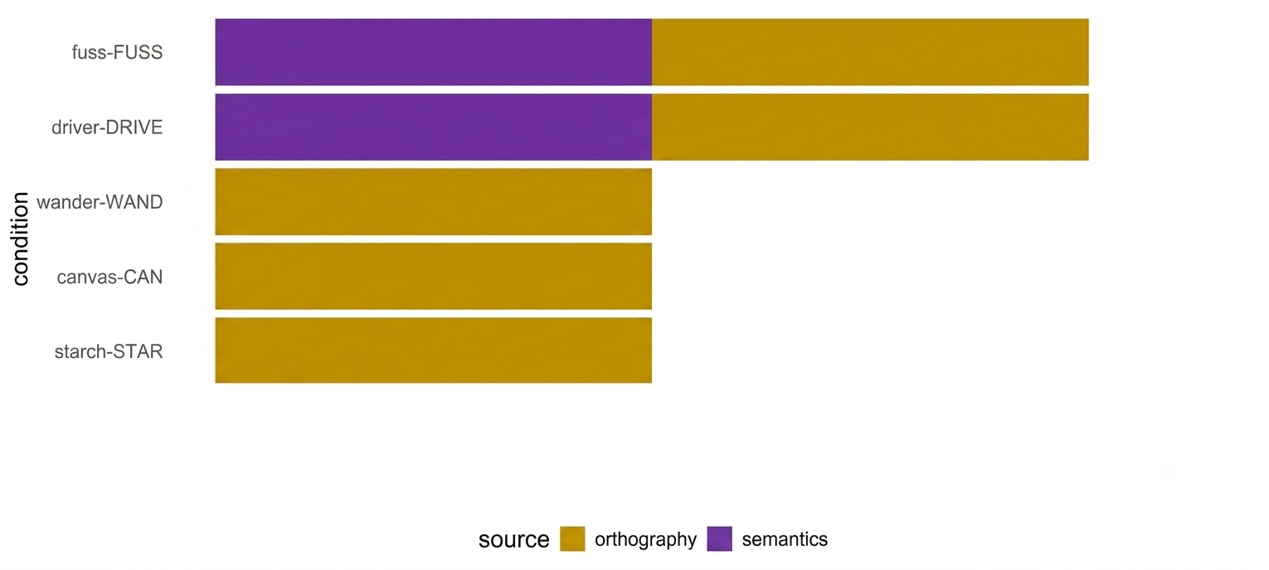
Interim summary
These results challenge the BMOD model that would instead predict M_{opaque} ≈ M_{transparent}
At the same time, they are compatible with two different models of (visual) word recognition.
1. Connectionist Triangle Model
(Seidenberg & McClelland 1989)
2. Lexical Decomposition
Model
Notes:
Three steps effect

Slide 30
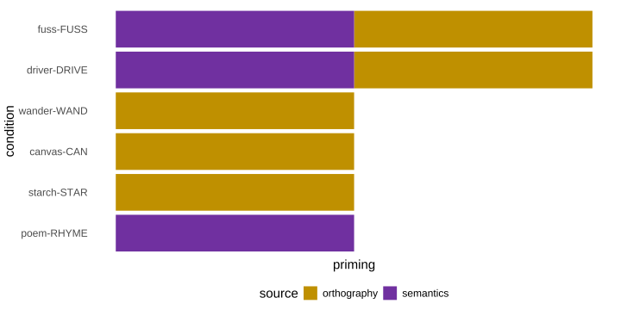
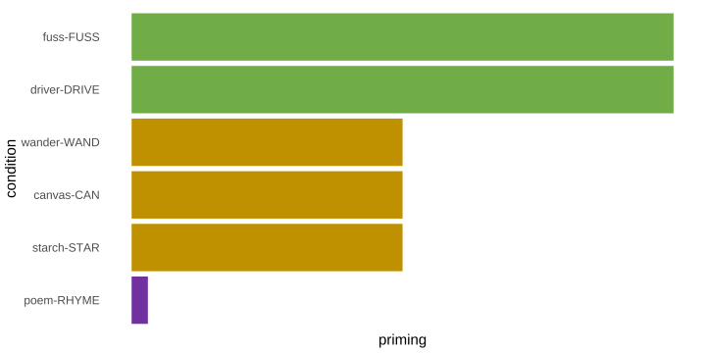
Interim summary
These results challenge the BMOD model that would instead predict M_{opaque} ≈ M_{transparent}
At the same time, they are compatible with two different models of (visual) word recognition.
1. Connectionist Triangle Model
(Seidenberg & McClelland 1989)
2. Lexical Decomposition
Model
Notes:
Three steps effect

Slide 31
This study
replications #6
# | Setting | Platform | Prime duration | Recruitment | Sample size
1 | in-lab | PsychoPy | 2 frames | University | 83
2 | online | PsychoJS | 33 ms | AMT | 139
3 | online | PsychoJS | 2 frames | AMT | 138
4 | online | Labvanced | 33 ms | Prolific | 167
5 | online | Labvanced | 33 ms | Prolific | 400
6 | online | Labvanced | 33 ms | Prolific | 3,000
total |  |  |  |  | 3,927
Replication #6 was not included in the meta-analysis, but underwent the same pre-processing pipeline, and then fed into a GLMM model
(with a Gamma distribution and log link).
Notes:
This method provides reliable effect estimates without assuming homogeneity of the effect sizes (unlike the fixed-coefficient model), nor random sampling (unlike the random-coefficient model) across studies.

Slide 32
This study
replications #6
identity: fuss-FUSS
transparent: painter-PAINT
opaque: wander-WAND
non-syllabic: starch-STAR
syllabic: canvas-CAN
semantic: poem-RHYME
Notes:
Here we are adding two more conditions to enhance the comparison across the relatedness dimensions (never done before after Raste et al. 2000)

Slide 33
This study
replications #6
identity: fuss-FUSS
transparent: painter-PAINT
opaque: wander-WAND
non-syllabic: starch-STAR
syllabic: canvas-CAN
semantic: poem-RHYME
elicits pure semantic effect alongside the other conditions (rarely done before)

Slide 34
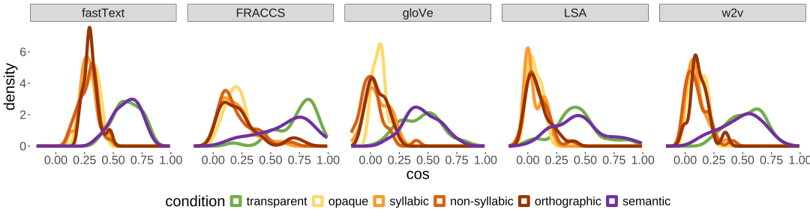
This study
replications #6
identity: fuss-FUSS
transparent: painter-PAINT
opaque: wander-WAND
non-syllabic: starch-STAR
syllabic: canvas-CAN
semantic: poem-RHYME

Slide 35
This study
replications #6
identity: fuss-FUSS
transparent: painter-PAINT
opaque: wander-WAND
non-syllabic: starch-STAR
syllabic: canvas-CAN
orthographic: basil-BASIN
semantic: poem-RHYME
factors out the stem activation effect and shows “true” orthographic effect

Slide 36
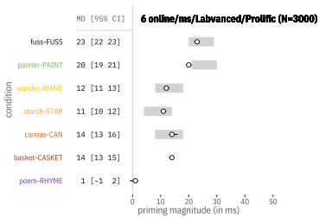
This study
replications #6 — GLMM results
M_{transparent} ≈ M_{identity}
M_{opaque} < M_{transparent}
Notes:
Remember to say something about the prediction intervals.

Slide 37
This study
replications #6 — GLMM results
M_{transparent} ≈ M_{identity}
M_{opaque} < M_{transparent}
M_{opaque} ≈ M_{ortho}

Slide 38
This study
replications #6 — GLMM results
M_{transparent} ≈ M_{identity}
M_{opaque} < M_{transparent}
M_{opaque} ≈ M_{ortho}
M_{semantic} ≈ 0
Notes:
After being pre-processed as in (A), the raw RT data was fitted with a Gamma distribution (identity link) in a GLMM, with condition, relatedness and their interaction as fixed factors, and subjects and items as random intercepts.

Slide 39
Conclusions
Our results challenges both the BMOD and connectionist models.
Notes:
It seems that the early sublexical morpho-orthographic decomposition hypothesis is refuted by the extant evidence.
pseudo-morphological priming patterned with purely orthographic priming;
2) morphological priming (ii) was instead indistinguishable from identity priming
This possibly indicating that these priming effects obtain at the lexical, rather than at the prelexical level, even at such brief visual presentations (here, 33ms).
3) Null result for associative semantic priming precludes an early involvement of semantic processes (such as spreading activation) at such prime durations, and ultimately suggests an independent, linguistically sophisticated level of morphological analysis.
The most parsimonious explanation for this set of facts is simply that masked morphological priming is not sublexical, not supralexical, but just lexical. This suggests that even very brief visual presentations (here, 33ms) are sufficient to lead to access to (some) lexical information, contrary to the assumption that only pre-lexical processes can occur during that time window.

Slide 40
Conclusions
Our results challenges both the BMOD and connectionist models.
“morpho-orthographic” regularities do not drive the masked morphological priming response.
Notes:
It seems that the early sublexical morpho-orthographic decomposition hypothesis is refuted by the extant evidence.
pseudo-morphological priming patterned with purely orthographic priming;
2) morphological priming (ii) was instead indistinguishable from identity priming
This possibly indicating that these priming effects obtain at the lexical, rather than at the prelexical level, even at such brief visual presentations (here, 33ms).
3) Null result for associative semantic priming precludes an early involvement of semantic processes (such as spreading activation) at such prime durations, and ultimately suggests an independent, linguistically sophisticated level of morphological analysis.
The most parsimonious explanation for this set of facts is simply that masked morphological priming is not sublexical, not supralexical, but just lexical. This suggests that even very brief visual presentations (here, 33ms) are sufficient to lead to access to (some) lexical information, contrary to the assumption that only pre-lexical processes can occur during that time window.

Slide 41
Conclusions
Our results challenges both the BMOD and connectionist models.
“morpho-orthographic” regularities do not drive the masked morphological priming response.
no additive contributions from the orthographic and semantics levels.
Notes:
It seems that the early sublexical morpho-orthographic decomposition hypothesis is refuted by the extant evidence.
pseudo-morphological priming patterned with purely orthographic priming;
2) morphological priming (ii) was instead indistinguishable from identity priming
This possibly indicating that these priming effects obtain at the lexical, rather than at the prelexical level, even at such brief visual presentations (here, 33ms).
3) Null result for associative semantic priming precludes an early involvement of semantic processes (such as spreading activation) at such prime durations, and ultimately suggests an independent, linguistically sophisticated level of morphological analysis.
The most parsimonious explanation for this set of facts is simply that masked morphological priming is not sublexical, not supralexical, but just lexical. This suggests that even very brief visual presentations (here, 33ms) are sufficient to lead to access to (some) lexical information, contrary to the assumption that only pre-lexical processes can occur during that time window.

Slide 42
Conclusions
Our results challenges both the BMOD and connectionist models.
“morpho-orthographic” regularities do not drive the masked morphological priming response.
no additive contributions from the orthographic and semantics levels.
LINGUISTIC SOPHISTICATION OF EARLY MORPHOLOGICAL DECOMPOSITION
~ early access to the actual morphological structure of words ~
Notes:
It seems that the early sublexical morpho-orthographic decomposition hypothesis is refuted by the extant evidence.
pseudo-morphological priming patterned with purely orthographic priming;
2) morphological priming (ii) was instead indistinguishable from identity priming
This possibly indicating that these priming effects obtain at the lexical, rather than at the prelexical level, even at such brief visual presentations (here, 33ms).
3) Null result for associative semantic priming precludes an early involvement of semantic processes (such as spreading activation) at such prime durations, and ultimately suggests an independent, linguistically sophisticated level of morphological analysis.
The most parsimonious explanation for this set of facts is simply that masked morphological priming is not sublexical, not supralexical, but just lexical. This suggests that even very brief visual presentations (here, 33ms) are sufficient to lead to access to (some) lexical information, contrary to the assumption that only pre-lexical processes can occur during that time window.

Slide 43
Thank you!
Notes:
It seems that the early sublexical morpho-orthographic decomposition hypothesis is refuted by the extant evidence.
pseudo-morphological priming patterned with purely orthographic priming;
2) morphological priming (ii) was instead indistinguishable from identity priming
This possibly indicating that these priming effects obtain at the lexical, rather than at the prelexical level, even at such brief visual presentations (here, 33ms).
3) Null result for associative semantic priming precludes an early involvement of semantic processes (such as spreading activation) at such prime durations, and ultimately suggests an independent, linguistically sophisticated level of morphological analysis.
The most parsimonious explanation for this set of facts is simply that masked morphological priming is not sublexical, not supralexical, but just lexical. This suggests that even very brief visual presentations (here, 33ms) are sufficient to lead to access to (some) lexical information, contrary to the assumption that only pre-lexical processes can occur during that time window.

